Slide 1


Machine Learning
Prof. Manisha
Manisha@careernow.us

Slide 2
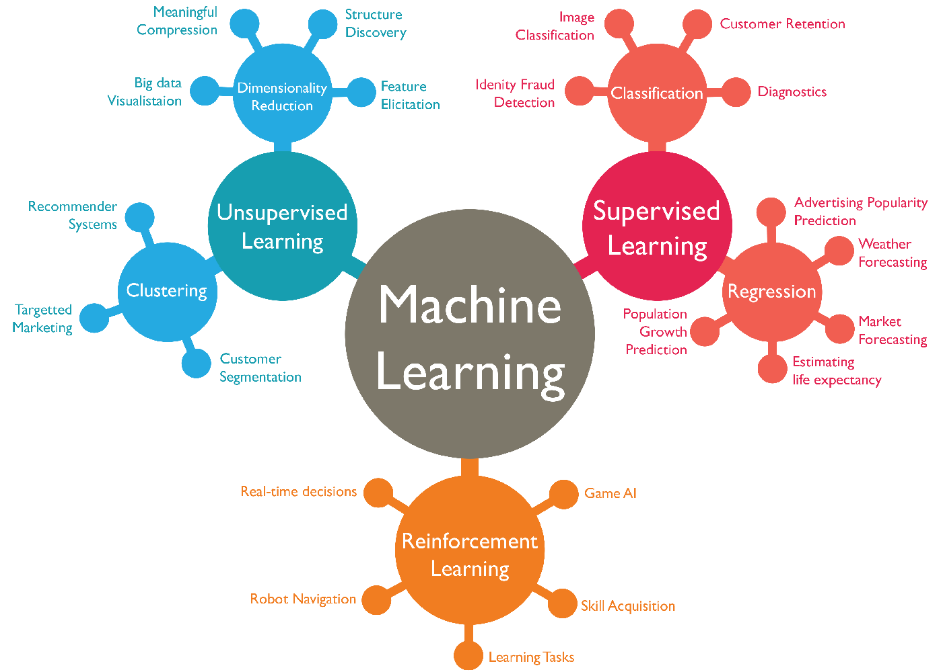

Slide 3



The Machine Learning Process
Data Pre Processing
Import the data
Clean the data
Split into training & and test sets
Feature Scaling
Modelling
Build the model
Train the model
Make predictions
Evaluation
Calculate performance metrics
Make a verdict

Slide 4
Regression models (both linear and non-linear) are used for predicting a real value, like salary for example. If your independent variable is time, then you are forecasting future values, otherwise your model is predicting present but unknown values. Regression techniques vary from Linear Regression to SVR and Random Forests Regression.
In this part, you will understand and learn how to implement the following Machine Learning Regression models:
Simple Linear Regression
Multiple Linear Regression
Polynomial Regression
Support Vector for Regression (SVR)
Decision Tree Regression
Random Forest Regression

Slide 5
Regression Simple Linear Regression

Slide 6
What is Regression?
Regression is a statistical method used to understand and quantify the relationship between two or more variables. It helps us predict or estimate the value of one variable based on the values of others.
Imagine you have a set of data points that represent pairs of related information, like the number of hours a student studies and the grade they achieve on a test. In regression, you'd use this data to build a mathematical model that describes the average relationship between study hours and test grades.
Analogy of the above:
Scenario: You want to know how the speed of a car (variable A) affects its fuel efficiency (variable B).
Regression: You collect data on various cars, noting their speeds and corresponding fuel efficiencies. Regression helps you create a formula or model that estimates how speed changes relate to changes in fuel efficiency.
Prediction: If you then encounter a new car with a certain speed, you can use your regression model to predict its likely fuel efficiency based on the patterns observed in your collected data.

Slide 7
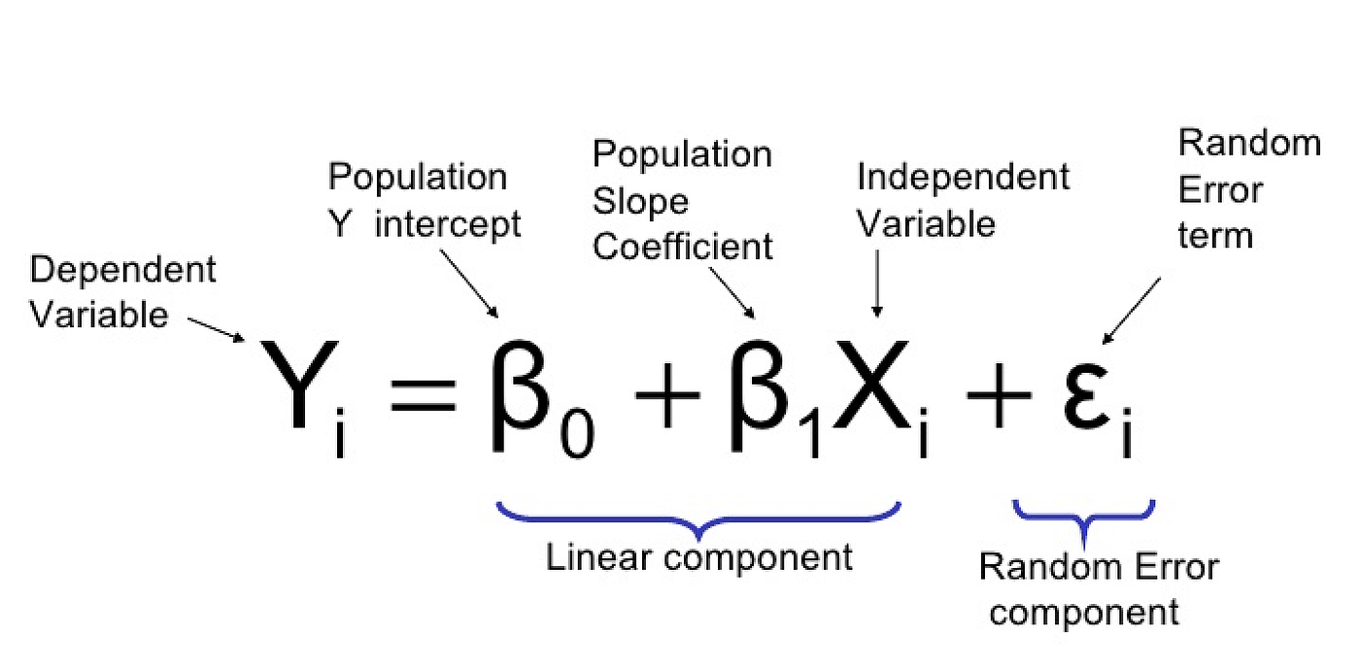
The main goal of regression analysis is to understand the relationship between a dependent variable (target) and one or more independent variables (features or predictors).
Mathematical Representation:
In simple linear regression, with one independent variable, the relationship is represented by a straight-line equation:

Slide 8
Key Concepts
Assumptions:
Linear regression assumes that the relationship between variables is linear and that residuals are normally distributed and have constant variance.
Interpretation of Coefficients:
The coefficients (beta1 and beta0) represent the change in the dependent variable for a one-unit change in the corresponding independent variable, assuming all other variables are held constant.
Goodness of Fit:
Measures like R-squared are used to evaluate how well the regression model fits the data. R-squared represents the proportion of the variance in the dependent variable explained by the independent variables.
Residual Analysis:
Analyzing residuals helps assess how well the model captures the variation in the data. Residuals are the differences between the observed and predicted values.

Slide 9
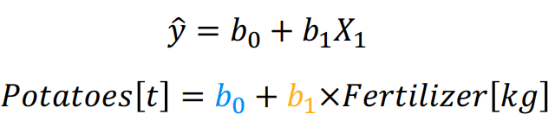

Example
Imagine you're a farmer trying to understand how the yield of potatoes is influenced by the amount of nitrogen fertilizer applied.
beta0​ (Y-intercept):
Mathematically: beta0​ is the estimated yield when no nitrogen fertilizer is applied.
Example: It's like the baseline yield you would expect even if you don't use any nitrogen fertilizer.
beta1​ (Slope):
Mathematically: beta1​ is the change in yield for a one-unit increase in nitrogen fertilizer.
Example: If beta1​ is 5, it means that, on average, each additional unit of nitrogen fertilizer increases the yield by 5 units.
ϵ (Error Term):
Mathematically: ϵ accounts for factors like weather, soil conditions, or pest control that can affect yield but are not considered in the model.
Example: It represents the variability in yield that can't be explained solely by the amount of nitrogen fertilizer.

Slide 10
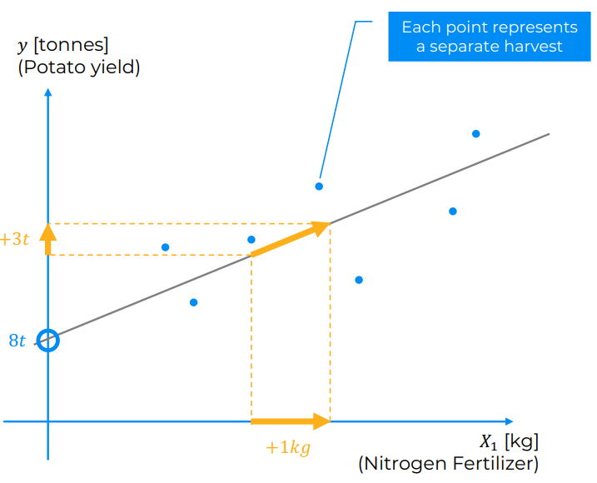
The slope of the line: This represents the change in the potato yield (y) for every unit increase in the nitrogen fertilizer applied (X₁). In this case, the slope appears to be positive, indicating that as the amount of fertilizer increases, the potato yield also increases.
The y-intercept: This represents the predicted potato yield when no fertilizer is applied (X₁ = 0). In this case, the y-intercept appears to be positive, indicating that even without fertilizer, there is some potato yield.
The scatter of the points around the line: This represents the residuals or the differences between the actual potato yield and the predicted yield based on the regression line. In this case, there is some scatter around the line, indicating that the linear model is not perfect and there may be other factors influencing the potato yield besides the amount of fertilizer applied.

Slide 11
Regression Ordinary Least
Squares

Slide 12
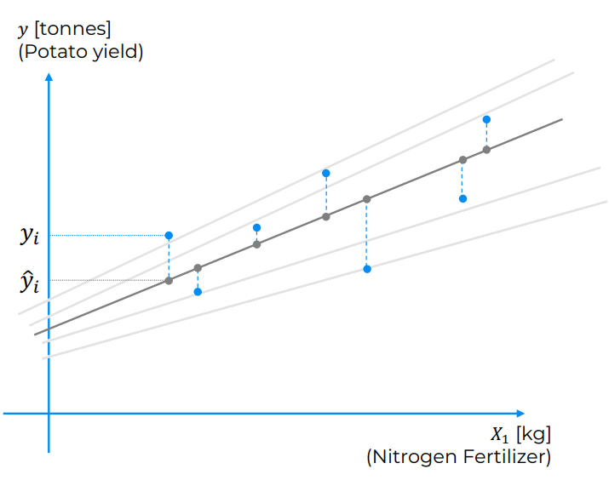
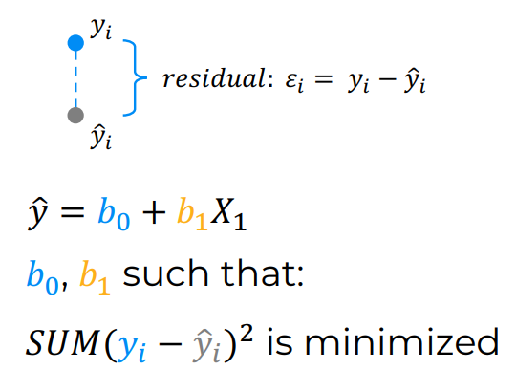
OLS is a method used to estimate the coefficients (beta0​ and beta1) in the simple linear regression equation. The goal is to minimize the sum of squared differences between the observed and predicted values. The formula for OLS estimation of the slope (beta1​) is

Slide 13
Imagine you've collected data on potato yield and the amount of nitrogen fertilizer applied to different plots. Now, you want to find the best-fit line that minimizes the squared differences between the observed and predicted yields.
Estimating beta1​ (Slope):
Mathematically: Calculate the slope using the formula, taking into account the differences between each data point and the mean of X and Y.
Example: It's like finding the average change in yield for a one-unit increase in nitrogen fertilizer across all your data points.
Estimating beta0​ (Y-intercept):
Mathematically: Once you have beta1​, use it to find the y-intercept by subtracting beta1Xˉ from the mean of Y.
Example: It's like determining the starting yield when no nitrogen fertilizer is applied based on the observed relationship.
The OLS method aims to find the values of beta0 and beta1​ that make the line fit the data points as closely as possible. The resulting equation represents the best linear relationship between nitrogen fertilizer and potato yield based on the observed data.

Slide 14
Regression Multiple Linear Regression

Slide 15
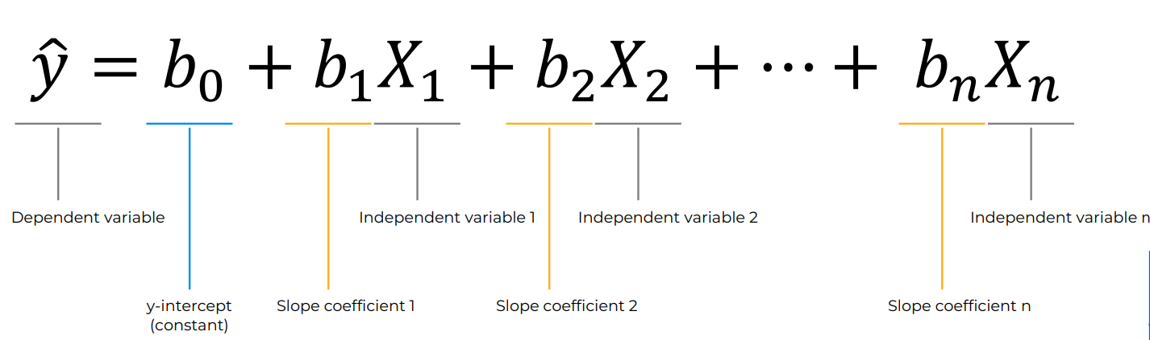
What is Multiple Linear Regression?
Multiple Linear Regression is an extension of Simple Linear Regression that allows us to predict a dependent variable (outcome) based on two or more independent variables (predictors). In other words, instead of just one independent variable, we now have multiple independent variables influencing the dependent variable.
The goal of multiple linear regression is to model the linear relationship between the explanatory (independent) variables and response (dependent) variables. In essence, multiple regression is the extension of ordinary least-squares (OLS) regression because it involves more than one explanatory variable.

Slide 16
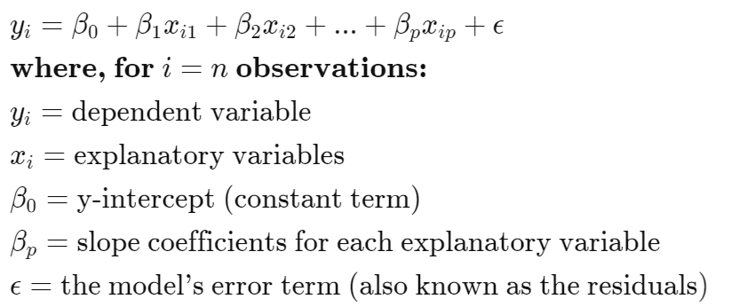
Formula and Calculation of Multiple Linear Regression
In multiple linear regression, with multiple independent variable, the relationship is represented by a straight-line equation:

Slide 17

Example
Imagine you're a farmer trying to grow the best potatoes possible. You know that nitrogen fertilizer is important for plant growth, but you also know that other factors like rainfall and temperature can play a role in your potato yield. So, you set out to experiment!
Planting your seeds:
Your plot: Each potato plant in your field represents a data point. You collect data on several factors that might affect their yields, such as the amount of nitrogen fertilizer used (measured in kilograms), the average temperature during the growing season (°C), and the total rainfall (in millimeters). These factors are your independent variables.
Your harvest: The amount of potatoes harvested from each plant represents your dependent variable, the potato yield. This is what you're trying to predict or explain.

Slide 18
Understanding the recipe
The formula you sent is like a recipe for understanding how these factors combine to influence your potato yield. It's a multiple linear regression model, which means it takes into account multiple independent variables at once.
Base amount: The constant term, 8t, represents the base yield you might expect even without any fertilizer, rain, or specific temperature. It's like the basic ingredients in your recipe that always go in, no matter what.
Fertilizer's impact: The term 3 × Fertilizer [kg] represents the effect of nitrogen fertilizer. The coefficient 3 tells you how much each kilogram of fertilizer increases the yield on average. It's like adding spices to your recipe; the more you add, the stronger the effect (up to a certain point).
Rain's influence: The term -0.54 × AvgTemp[°C] represents the effect of average temperature. The negative coefficient means that higher temperatures tend to decrease the yield, just like adding too much of ingredients can spoil your dish.
Rainfall's contribution: The term 0.04 × Rain[mm] represents the effect of rainfall. The positive coefficient means that more rain generally leads to higher yields, similar to how water is essential for most recipes.

Slide 19
What Multiple Linear Regression Can Tell You?
Simple linear regression is a function that allows an analyst or statistician to make predictions about one variable based on the information that is known about another variable. Linear regression can only be used when one has two continuous variables—an independent variable and a dependent variable. The independent variable is the parameter that is used to calculate the dependent variable or outcome. A multiple regression model extends to several explanatory variables.
The multiple regression model is based on the following assumptions:
There is a linear relationship between the dependent variables and the independent variables
The independent variables are not too highly correlated with each other
y_{i} observations are selected independently and randomly from the population
Residuals should be normally distributed with a mean of 0 and variance σ
https://www.mdpi.com/2073-4395/11/5/885

Slide 20
Regression R square

Slide 21
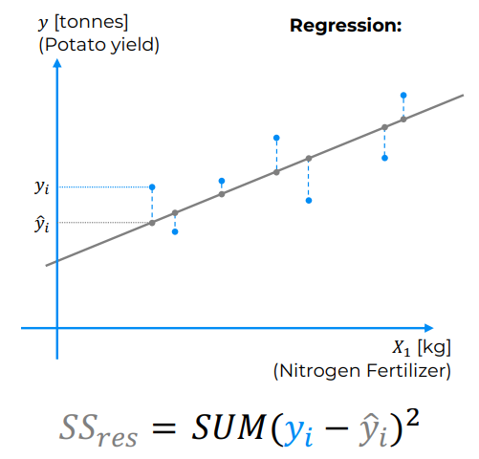
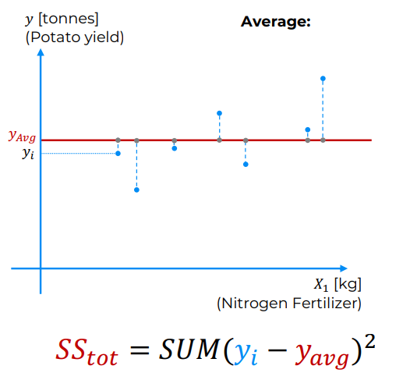
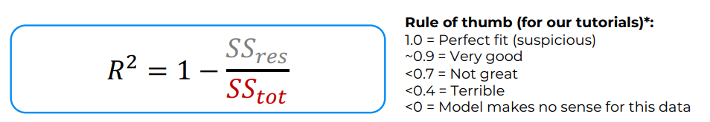

Slide 22
R-squared is a statistical metric used to assess the goodness of fit of a linear regression model. It represents the proportion of variance in the dependent variable (what you're trying to predict) that can be explained by the independent variables (the features you used to make the prediction).
It ranges from 0 to 1, where 0 indicates the model explains no variance and 1 indicates it explains all variance.
Generally, a higher R-squared value is considered better, but it's not the only factor to consider when evaluating a model.
Rule of Thumb:
The image provides a rule of thumb for interpreting R-squared values in the context of tutorials or educational examples:
1.0: This is considered a perfect fit, but it's often suspicious in practice, as it might indicate overfitting (the model memorized the training data too well and may not generalize well to unseen data).
~0.9: This is considered a very good fit, indicating the model explains a large portion of the variance.
<0.7: This is considered not great, suggesting the model explains less than 70% of the variance and there's room for improvement.
<0.4: This is considered terrible, as the model explains less than 40% of the variance and might not be very useful.
<0: This means the model makes no sense for the data, as it performs worse than just predicting the average value of the dependent variable.

Slide 23
The coefficient of determination (R-squared) is a statistical metric that is used to measure how much of the variation in outcome can be explained by the variation in the independent variables. R2 always increases as more predictors are added to the MLR model, even though the predictors may not be related to the outcome variable.
R2 by itself can't thus be used to identify which predictors should be included in a model and which should be excluded. R2 can only be between 0 and 1, where 0 indicates that the outcome cannot be predicted by any of the independent variables and 1 indicates that the outcome can be predicted without error from the independent variables.
When interpreting the results of multiple regression, beta coefficients are valid while holding all other variables constant ("all else equal"). The output from a multiple regression can be displayed horizontally as an equation, or vertically in table form.

Slide 24
Regression Adjusted R square

Slide 25
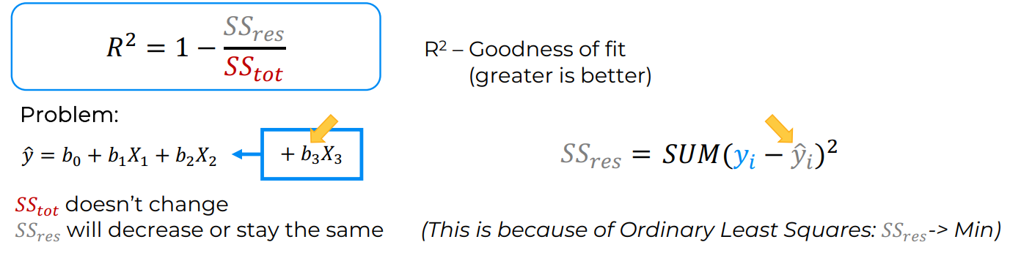
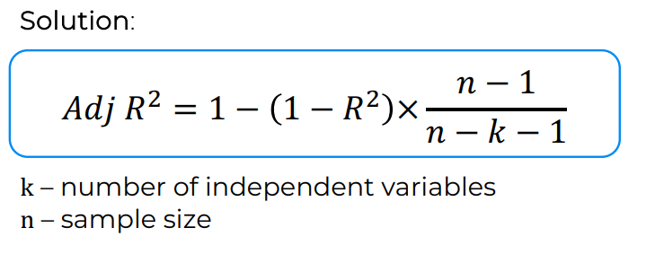
Adjusted R-squared is a modified version of R-squared that accounts for the number of predictors (independent variables) in your linear regression model. It penalizes models for added complexity, attempting to offer a more accurate estimate of the model's predictive power on new, unseen data.

Slide 26
Regression Assumptions Of
Linear Regression

Slide 27
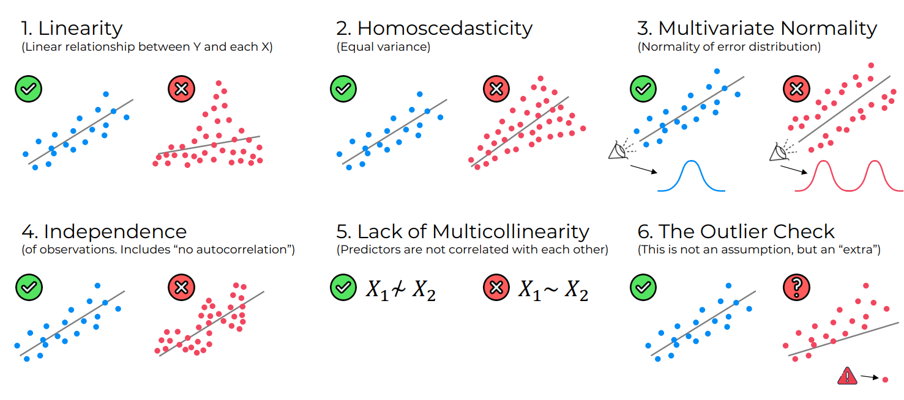

Slide 28
Linearity:
Assumption: The relationship between the independent variables and the dependent variable should be linear.
Example: Suppose you're analyzing the relationship between hours studied and exam scores. You expect that as the number of hours studied increases, the exam scores also increase proportionally. If you plot the data points on a scatter plot and draw a straight line through them, the line should capture the overall trend of the data.
Independence:
Assumption: Each observation in the dataset should be independent of others.
Example: In a survey where you collect data from different individuals, each participant's response should not be influenced by the responses of others. For instance, if you're surveying people's opinions on a political issue, one respondent's opinion should not affect another respondent's opinion.
Homoscedasticity:
Assumption: The variance of the residuals (errors) should be constant across all values of the independent variables.
Example: Consider a model predicting house prices based on the size of the house. Homoscedasticity implies that the spread of the residuals (the differences between predicted and actual prices) should be similar across all sizes of houses. In other words, the errors should not systematically increase or decrease as the size of the house changes.

Slide 29
6. Normality of Residuals:
Assumption: The residuals (errors) should follow a normal distribution.
Example: After fitting a Linear Regression model, you examine the distribution of residuals. Ideally, the histogram of residuals should resemble a bell-shaped curve, indicating a normal distribution. Deviations from normality could suggest that the model may not be capturing all the relevant information in the data.
7. No Multicollinearity:
Assumption: There should be no strong correlations among the independent variables.
Example: Suppose you're predicting a student's GPA based on hours studied and attendance in class. If there's a high correlation between hours studied and attendance (i.e., students who study more tend to attend class more), it may cause multicollinearity issues. In such cases, it becomes challenging to determine the individual effect of each predictor on the dependent variable.
8. No Autocorrelation:
Assumption: The residuals should not exhibit any patterns or trends over time.
Example: In time series data predicting stock prices, autocorrelation occurs if the error terms from one day are correlated with the error terms from the previous day. It suggests that the model is not capturing all the information from the data, and there may be systematic patterns left unexplained.

Slide 30
Regression Assumptions Of
Linear Regression

Slide 31
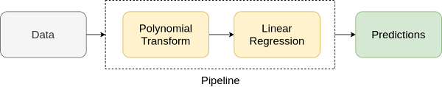
Introductions
Imagine you have a dataset that shows the relationship between the amount of fertilizer used and the growth of plants. You want to understand how the growth of plants changes as you increase the amount of fertilizer applied.
Now, if you plot the data points on a graph, you might notice that the relationship between fertilizer amount and plant growth doesn't seem to be a straight line. Instead, it looks like a curve.
https://www.analyticsvidhya.com/blog/2021/07/all-you-need-to-know-about-polynomial-regression/

Slide 32
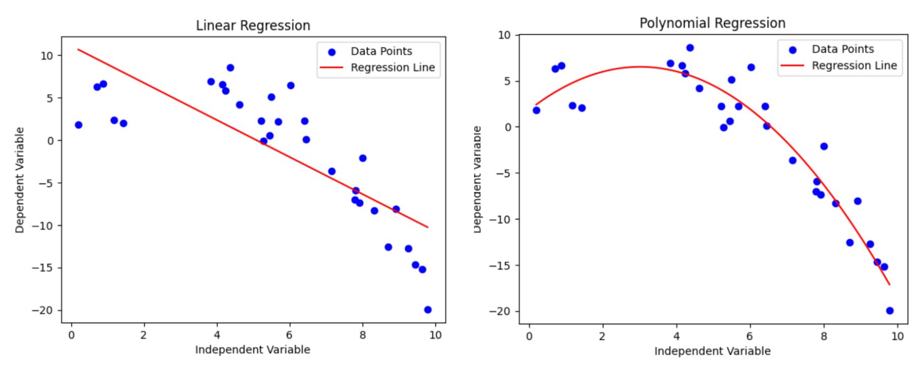
Polynomial regression is a technique used in statistics and machine learning to model non-linear relationships between variables. It's a powerful tool for analyzing data where a straight line wouldn't accurately capture the underlying trend.
Here's a breakdown of the key concepts:
1. The basic idea:
Imagine you have data points scattered on a graph. Simple linear regression tries to fit a straight line to these points, minimizing the distance between the line and the data. But what if the points follow a curve? That's where polynomial regression comes in.

Slide 33
2. Fitting the curve:
Polynomial regression uses polynomial equations instead of straight lines. These equations can be of various degrees, meaning they have different levels of complexity. For example:
Linear equation: y = mx + b (straight line)
Quadratic equation: y = mx^2 + bx + c (curve with a maximum or minimum)
Cubic equation: y = mx^3 + bx^2 + cx + d (more complex curve)
3. Choosing the right polynomial:
The key is to choose the right degree of polynomial for your data. Too low (e.g., linear) might not capture the curve, while too high could lead to overfitting (memorizing the data without generalizing well).
4. Finding the best fit:
Similar to linear regression, polynomial regression uses optimization techniques to find the polynomial equation that best fits your data points, minimizing the error between the predicted values and the actual values.
5. When to use it:
Polynomial regression is useful when you have visual evidence of a non-linear relationship in your data. However, it's important to be cautious of overfitting and choosing the right polynomial complexity.

Slide 34
